Slide 1

Optimizing VC Investments
Pavan, Tiffany, Nishant
19 October 2017
Notes:
Pavan Kurapati
Team members by order of appearance:
Pavan Kurapati
Tiffany Jaya
Nishant Velagapudi

Slide 2
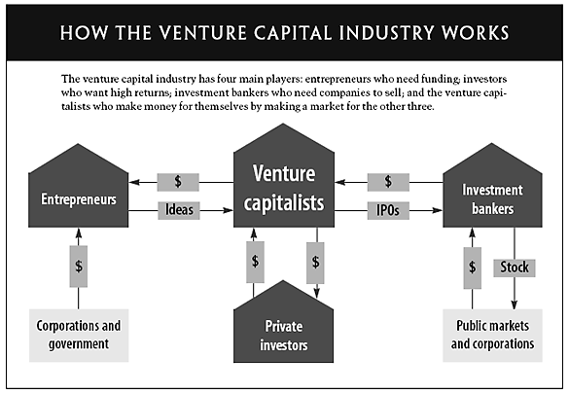
Notes:
Pavan Kurapati
To provide a broader perspective, here is a diagram of how venture capital works as discussed in the previous slide.
Long:
To provide a broader perspective of how venture capital works, venture capitalists raise money from limited partners (aka private investors) and fund entrepreneurs in their start-up. At the end, when the companies go public, VCs will sell the company’s shares and hope to earn as much of the 20% profit from the sell to make money successfully for themselves as well as their investors.

Slide 3


Venture Capitalists (VC)
Goal: 3-5 times returns
Private Investors
(Limited Partners)
Entrepreneurs
What startup gains from VC:
- capital
- networking
- business acumen
What LP gains from VC:
- 3 - 5 times return
from investment
What VC gains from LP:
- Money to invest in startup
- 2%/year management fee
- 20% profit when startup IPO
What VC gains from startup:
- 20% profit when startup IPO
Notes:
Pavan Kurapati
Venture Capitalism raise money from a pool of capital known as limited partners, which include accredited individuals and large financial institutions. Their goal is to get a return of at least 3-5 times committed capital by purchasing shares of start-up companies and selling them for significant gains when these companies go public. Typically, VC operates under the 2 and 20 structure whereby they will charge limited partners 2% annually for operating expenses and 20% profit for selling the company’s shares. So it is in their best interest to assist entrepreneurs for success in order to gain as much of the 20% profit as possible.

Slide 4

Core Business Problem
Low return rate - only earning 2.6% interest rate
Notes:
Speaker Name
“VCs as a class earned 2.6% interest rate for their investors--less than you could have earned in a S&P 500 index fund.” You would be better off going to the roulette table in Las Vegas than investing with a VC.

Slide 5





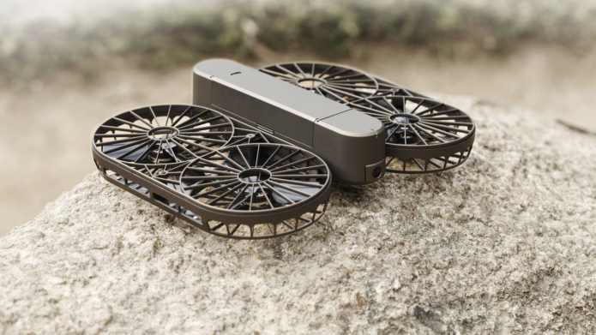
Growing Competition
Notes:
Pavan Kurapati
Some businesses have gone into the practice of crowdfunding instead of looking for true Venture Capital backing. This has lesser administrative burden. Crowdfunding poses a threat to eat into VC opportunity, as entrepreneurs will be able to promise products instead of company equity to receive infusions of cash. This threat will hopefully push venture capitalists to be willing to adapt new technologies to gain an advantage. VCs may be unused to the idea of concept competition - as they have solely owned the domain for quite some time. An example is home robots or small technology (wearables, etc.) - Jibo raised more than $1 million in crowd funding, eliminating the need and downside for entrepreneurs of venture capitalism. Crowdfunding industry raised $34 billion in 2015 from a meager $2.7 billion in 2012.

Slide 6

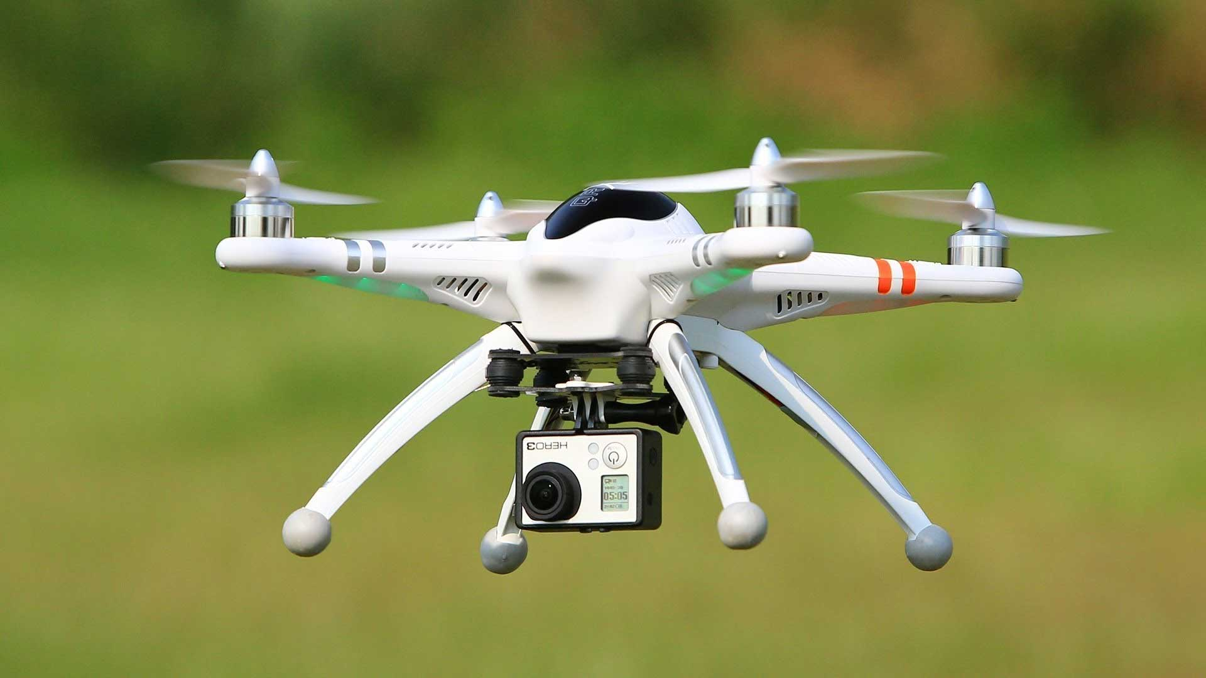
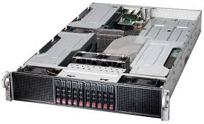
Right Industry & Technology
Notes:
Pavan Kurapati
Investments in the right technology matters a lot, especially in the world where technology becomes obsolete in a span of 1 or 2 decades.
Disk drive industry was a darling for VCs to invest in 1980s. By 1984, the industry market value plunged from $5.4 billion to $1.4 billion

Slide 7
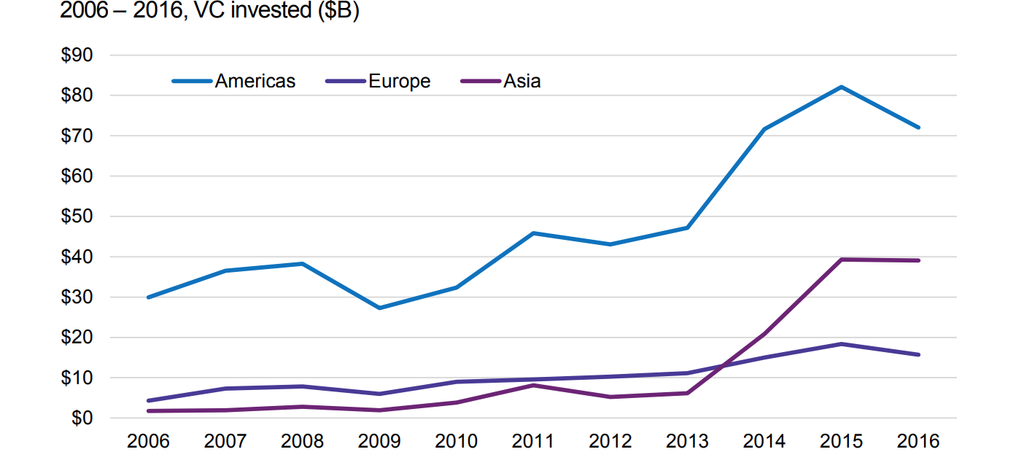
Which company to invest in - locally?
Source : KPMG Venture Pulse 2016
Notes:
Pavan Kurapati
VCs suffer from a locality bias - they are more likely to invest in companies that are geographically near to them. However, while Asia’s total venture capital investment has remained steady, the VC activity in the Americas and Europe fell significantly ($82 -> $72 billion and $18 to $16 billion respectively). The locality bias is highly logical - local businesses are easier to familiarize, involve less risk of the unknown (either in terms of legislature or market pitfalls).

Slide 8
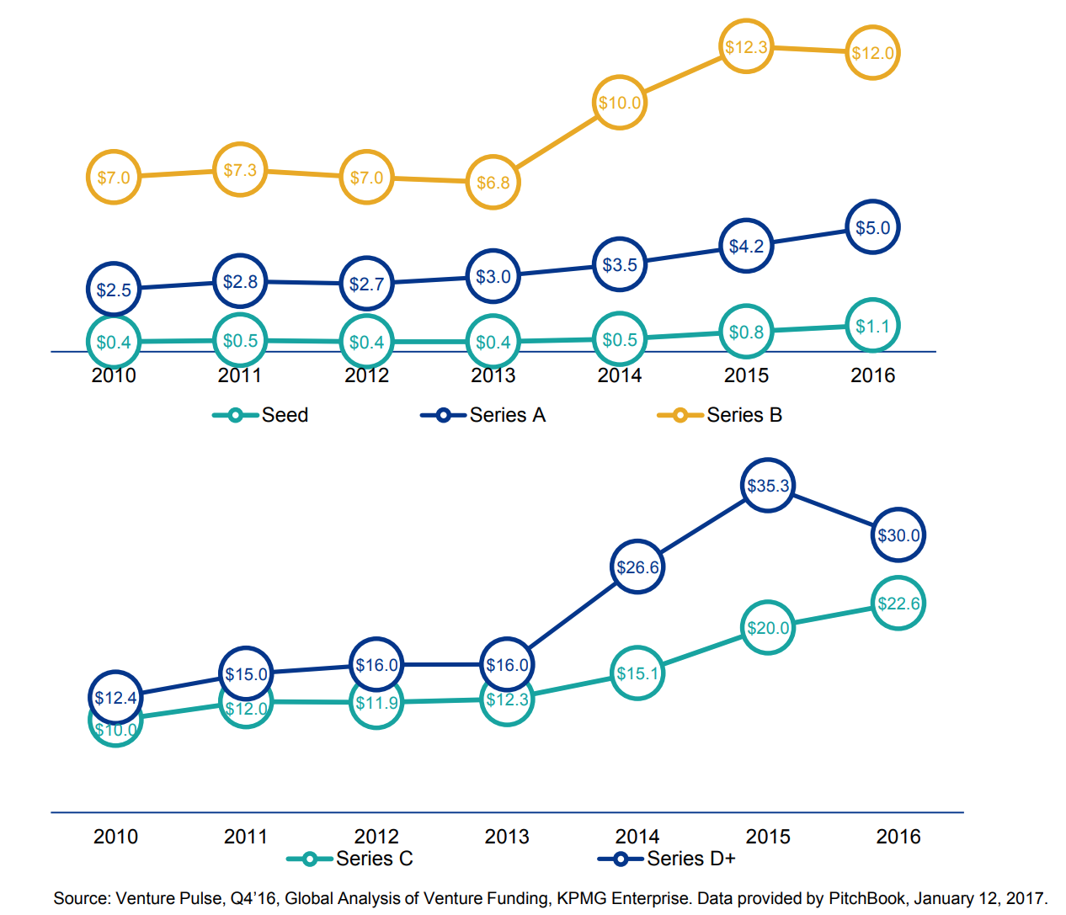
When to invest?
Investment returns vary by stage of investment
Early investments in the form of seed funding/Series A have high risk due to uncertain technology
Late investments can result in competitive shakeouts and consolidations
80% of VC funding goes into building infrastructure to “grow”
Notes:
Pavan Kurapati
Part of deciding what to invest in is deciding what “stage” of a company is safe to invest in. Investing later in the process means that the companies are more stable and shares will be more expensive. At the same time, investing earlier in the life cycle of a company is riskier. 80% of the money invested by VCs goes into companies in their “adolescent phase.” However, it is possible that risk averse behavior leads to greater investment in slightly older start-ups. Companies in their true startup phase have less of a track record and thus attract less attention. On the other hand, there is significant investor caution for late stage deals - potentially because companies requiring late stage investment have some hidden problems. Median deal sizes have increased for startup stage companies from 2015 to 2016, while median deal sizes for adolescent companies has held steady.

Slide 9

Problem Cause #1
with Limited Partners
Investors fall prey to
social norm bias
Notes:
Tiffany Jaya
Part of the reasons why these problems occur is because of fallacies and biases people have. Limited partners fall prey to social norm bias. They accept the risk of investing with VCs even though VCs have failed to return their capital. They don’t held VCs accountable which is part of the reason why the problem persists.

Slide 10





Special Pleading Fallacy
Narrative Fallacy
The thought that your field is immune to change
Adding explanation to facts that isn’t there
Problem Cause #2
with Venture Capitalists
Bimodal Returns Fallacy
Confirmation Bias
&
Group Mentality
Only see investment returns as either a total bust or a unicorn
Notes:
Tiffany Jaya
But venture capitalists are more inclined to err on common fallacies. For the longest time, VCs tend to find their own field immune to change. This special pleading fallacy is partly a result of a historical but successful paradigm established by the fact that they used to be a relatively small group who have access to the best deals and therefore have better success than they do see now. But with increase funding and new approaches (like crowdfunding discussed earlier i.e. Y Combinator, Kickstarter, or super angels), the number of great startup ideas remain the same but there is more competition vying for the best deals.
In addition, the human mind is not great at piecing facts together. We commonly create stories to explain what isn’t there and in the process we fool ourselves into thinking that we can predict the future. VCs are encountering the same narrative fallacy. They want to overreach correlation between two unlike things. It’s the same as a person who wants to fly and creates a pair of feathered wing because he observed things that fly have feathers. Similarly, VCs often times over-extrapolate and think if it worked for Uber it should work for Uber for X.
Since the goal of VCs is to get a high return on their investment, they have a tendency to view the return on startup as bimodal outcome: either it is a total bust or it is a unicorn like Google. But startup returns are not bimodal; they exhibit more of a power law curve. Sure, there will be 15 unicorns which will break into the $100 million revenue, but most companies will be somewhere along the middle. It is plausible to build these companies into having $100 million in revenue, but it will take years to do so (approximately 6-12 years). The adherence to the bimodal returns fallacy causes two bad behaviors. One, VCs feel the need to do every deal so that you can catch one big winner. Two, companies that are anointed as unicorns are valued higher than public market is willing to pay.
To make matter worse, venture capitalism have long feedback cycles. A typical partner in VC firm holds only one or two deals a year. In a span of 10 years, they might only invest in 15 different companies, so they will not know if their decision in investing a certain company result in a good or bad outcome. It becomes easy to confuse luck with skill. For this reason, it is easy for VCs to use any information to confirm their way of thinking; they can be subject to a confirmation bias or a group mentality by validating with other VCs their investment in a coffee session. The result is a biased judgment where a group of VCs are going after the same market at the same time. It’s bad news all around.
So how are we going to solve these problems? Nishant will explain to us the different ways we can overcome the core business problem as well as the fallacies and biases involved.

Slide 11




Research Question
How can venture capitalists make better investments?
STEP 1
STEP 2
STEP 3
Which industry to invest in?
Which company to invest in?
When do you invest?
Web crawling
Financial modeling
Identify paradigm shifts
Translation between models and business intelligence
Evaluate best ways to add value (insights versus data)
Question is linked with what to invest in
Notes:
Nishant Velagapudi
What components within a company that

Slide 12

Resources
CB Insight
CB Insight Company Mozaic
Collect data for data origination
Assess the health of private companies for deal origination
InReach DIG
Deep Knowledge VITAL
Collect data when company is in stealth mode for deal origination
Existing model based intelligence that analyses financial and scientific data to better inform investment decisions made by partners and the board of directors
Notes:
Nishant Velagapudi
Here are a list of data sources that we will not discuss due to time constraint, but feel free to reach out during the Q&A.

Slide 13

How will this research help?
Identify which industries are “trending”
Use search methods in a novel manner for this purpose
Combine with traditional methods of identifying trends
Attempt to highlight best companies
Search methods offer way around locality
Offer data as well as insights - leverage SME
1
2
3
Historical analysis on
risk / reward for
series A vs B investments
On a vertical by vertical basis
4
Profit
Notes:
Nishant Velagapudi

Slide 14

Impact
We expect to provide a novel advantage to early adopters of our model.
VCs can leverage the power of search to broaden their perspective on how a certain start-up is viewed
We want to equip VCs to get out of their “comfort zones” as investors
Lower risk of failure and associated costs
Counter the threat of crowd-funding to venture capitalism by improving overall results.
Notes:
Nishant Velagapudi

Slide 15






Challenges & Obstacles
How we build models
Models are only as good as how we build them
Confirmation Bias
VC can fall in love with
the startup
Changing mindset
Overlook long-term growth
Information Overload
More information increases confidence than accuracy
Technical challenges
Sparse datasets
VCs are not willing to
share data
Bias against diversity
Similarity bias
Locality bias
Gender bias
Notes:
Tiffany Jaya
Of course, there will be challenges involved in this process. We have to convince VCs in this new approach.
Even when we are able to determine which companies are good candidates to invest, the models are only as good as the business theories that are applied. We have to be flexible enough to take recommendations from VCs and incorporate that to our machine learning pipeline. Google Ventures are among the first to have accomplished this feat, pulling out a performance 3.5 times higher than the industry average.
But models are only as good as how we develop them. If we replicated the way humans perform into the machine learning model, it will also incorporate the same fallacies and biases VCs encounter.
These biases include biases to confirmation bias, biases to strengthen confidence in biases, and biases against diversity.
Models will not be able to avoid these biases. In addition, we also cannot change the VCs’ mindset. For example, easy short-term growth is now highly valued in Silicon Valley that we often overlook the meaningful long-term growth that matter because these markets are challenging and don’t quite produce a profit in the short run.

Slide 16



Q U E S T I O N S
Pavan - pkurapati@berkeley.edu
Tiffany - tiffanyjaya@berkeley.edu
Nishant - nishray@berkeley.edu
Notes:
Tiffany Jaya
So I hope you enjoy our talk. If you have any question, please feel free to reach us at the email addresses listed below. Thank you for listening to our presentation.

Slide 17
Bibliography
https://hbr.org/1998/11/how-venture-capital-works
https://assets.kpmg.com/content/dam/kpmg/xx/pdf/2017/01/venture-pulse-q4-2016-report.pdf
https://www.kauffmanfellows.org/journal_posts/applying-decision-analysis-to-venture-investing/
https://techcrunch.com/2012/07/29/the-paradox-of-vc-seed-investing/
https://www.fastcompany.com/1826876/googles-creative-destruction
https://mattermark.com/venture-capitalists-cognitive-bias-and-why-past-isnt-always-prelude/
http://www.acuitasinvestments.com/insights/Kauffman_VC_paper.pdf
https://medium.com/@ArtofJina/the-vc-industrys-identity-crisis-e83639d2ff60
https://www.kauffmanfellows.org/journal_posts/applying-decision-analysis-to-venture-investing/
https://www.mckinsey.com/industries/high-tech/our-insights/a-machine-learning-approach-to-venture-capital
https://hbr.org/2012/06/is-venture-capital-broken
https://medium.com/book-bites/the-san-francisco-fallacy-cb7031d6a4d2
https://medium.com/@libbykinsey/the-ai-fallacy-and-special-pleading-bdfba9173bd4
http://avc.com/2010/10/the-fallacy-of-bimodal-returns/
https://www.inc.com/erik-sherman/the-1-percent-fallacy-that-trips-many-entrepreneurs.html
https://www.strictlyvc.com/2014/12/05/15-meme-fallacy/
https://www.strictlyvc.com/2014/12/01/many-tech-companies-break-year/
http://benhamouglobalventures.com/2015/08/18/the-fallacy-of-unicorn-hunting/
http://www.mahesh-vc.com/blog/silicon-valley-logic-is-riddled-with-fallacies
https://www.cfainstitute.org/learning/products/publications/faj/Pages/faj.v62.n6.4350.aspx
https://a16z.com/2010/04/13/four-things-some-vcs-do-that-i-dont-like/
https://www.vox.com/policy-and-politics/2017/7/1/15887182/gender-bias-venture-capital
https://techcrunch.com/2015/09/24/the-surprising-bias-of-venture-capital-decision-making/
https://medium.com/startup-grind/6-hidden-biases-of-early-stage-vcs-83c23c05a53e
https://www.theinformation.com/the-sunk-cost-fallacy-and-the-future-of-silicon-valley

